Slide 1
Cafeteria Management System
Presented by: Md. Arif Hossain
Roll: 190612
Session: 2018-2019
Supervisor: Akif Mahdi
Department of Information and Communication Engineering Pabna University of Science and Technology

Slide 2
Introduction
Traditional cafeteria systems are either manual or poorly digitized.
Common issues include:
No role-based interface
Delay in order updates
No real-time communication
No feedback mechanism
These gaps lead to inefficiency, customer dissatisfaction, and staff mismanagement.
Goal: To design and implement a real-time, multi-panel system with role segregation.
Cafeteria Management Systems

Slide 3
Literature Review
System/Study | Features | Limitations
Manual Cafeteria Systems | Paper-based, human-driven | High error rate, time-consuming
Basic POS Terminals | Order entry & billing | No role distinction, no feedback
Single-panel Cafeteria Software | Digital dashboard | Confusion, lack of access control
Existing Web Solutions (Limited) | Order tracking | No table reservation or user rating
Cafeteria Management Systems

Slide 4
Objectives
Develop a MERN-based modular cafeteria system
Implement 5 role-based panels: Admin, POS, Kitchen, Billing, Customer
Integrate:
Real-time socket communication
Secure JWT authentication
Feedback & rating system
Smart table reservation system
Tools: React, Node.js, Express, MongoDB, Socket.IO
Cafeteria Management Systems

Slide 5
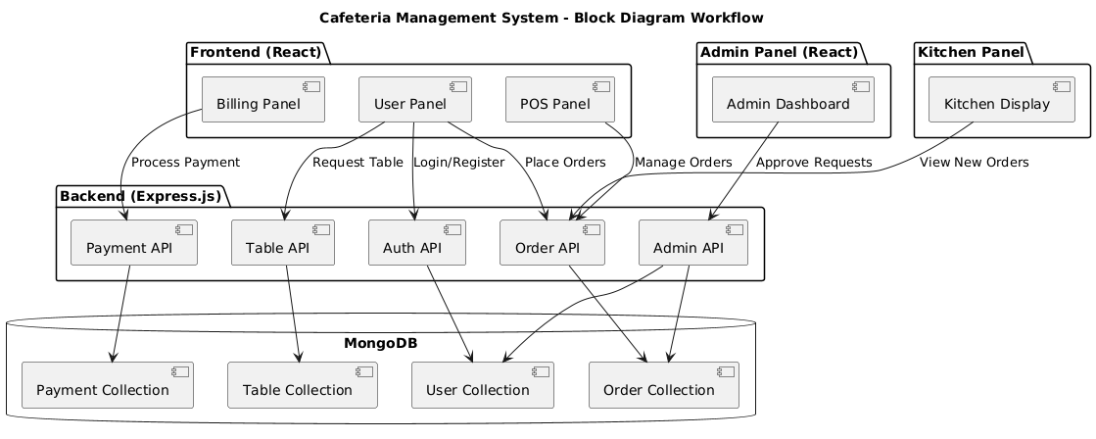
Methodology
Experimental Workflow of the Cafeteria Management System:
Cafeteria Management Systems

Slide 6
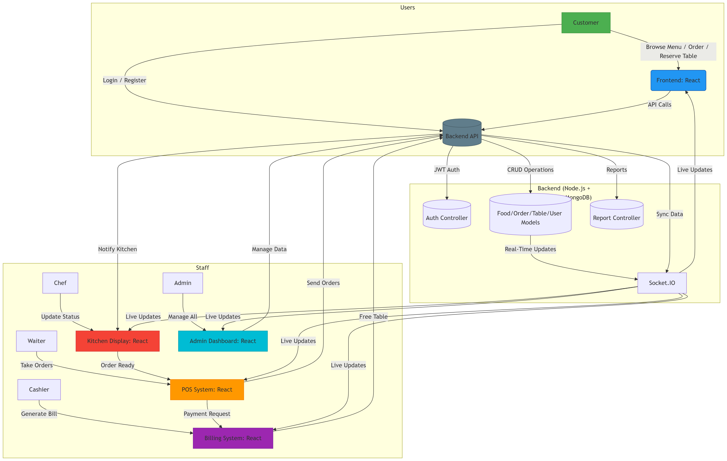
Methodology
System Architecture of the Role-Based Cafeteria Management System:
Cafeteria Management Systems

Slide 7
Methodology
Modular Panels:
Admin: Manage menu, tables, staff ,approve or reject reservations, Monitor and manage inventory ,kitchen supplies and orders, View feedback and sales reports
POS: Taking orders, communicate with the kitchen ,Place orders for reserved tables
Kitchen: Update food status (ready, preparing)
Billing: Generate invoice, download PDF
Customer: Menu Browsing , Order Placement, Reserve tables, submit feedback
Cafeteria Management Systems

Slide 8
Results
Features | Traditional Systems | Proposed System
Role-Based Access | Not Available | Fully Implemented
Real-Time Order Updates | Not Supported | Fully Supported via WebSocket
Table Reservation | Not Available | Available with Admin Approval
Feedback Collection | Absent | Integrated Feedback and Rating System
Inventory Integration | Not Integrated | Fully Integrated with Admin Panel
Multi-Panel Architecture | Single Panel Used | Distinct Panels for Each Role
Cafeteria Management Systems

Slide 9
Conclusion and Future Work
Conclusion:
This Role-Based Smart Cafeteria Management System successfully addresses key limitations found in traditional and semi-digital systems.
By implementing:
Real-time communication via WebSocket (Socket.IO),
Role-based panel segregation,
Smart reservation and feedback systems,
the solution enhances operational efficiency, user satisfaction, and administrative control.
Future Work:
Add multilingual support
Machine learning for demand forecasting
Mobile app version for broader accessibility
Cafeteria Management Systems

Slide 10
Thank You

